Slide 1
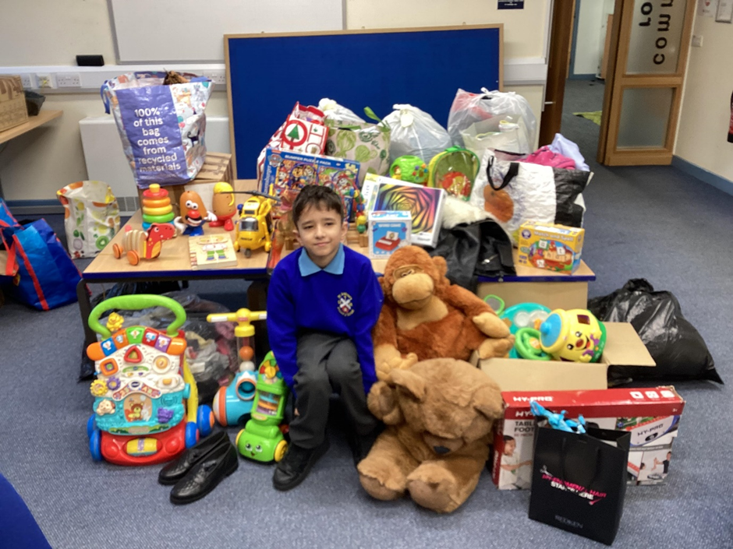
Reuben – Year 4
Reuben was really concerned for the people living at Billing Aquadrome when he heard how the site had been evacuated during the recent floods.
He asked if we could run an appeal for toys, clothing at essential items that we could give to those in need.
He wrote a letter, which we shared with all of our families, and the donations came rushing in!
Thankfully, most families at Billing were not as badly impacted as first thought, so the donations will go to a Domestic Violence charity that supports families who have to leave their homes very quickly.
I ASPIRE: INDEPENDENCE AMBITION SELF-CONTROL PERSEVERENCE INTEGRITY RESPONSIBILITY EMPATHY

Slide 2
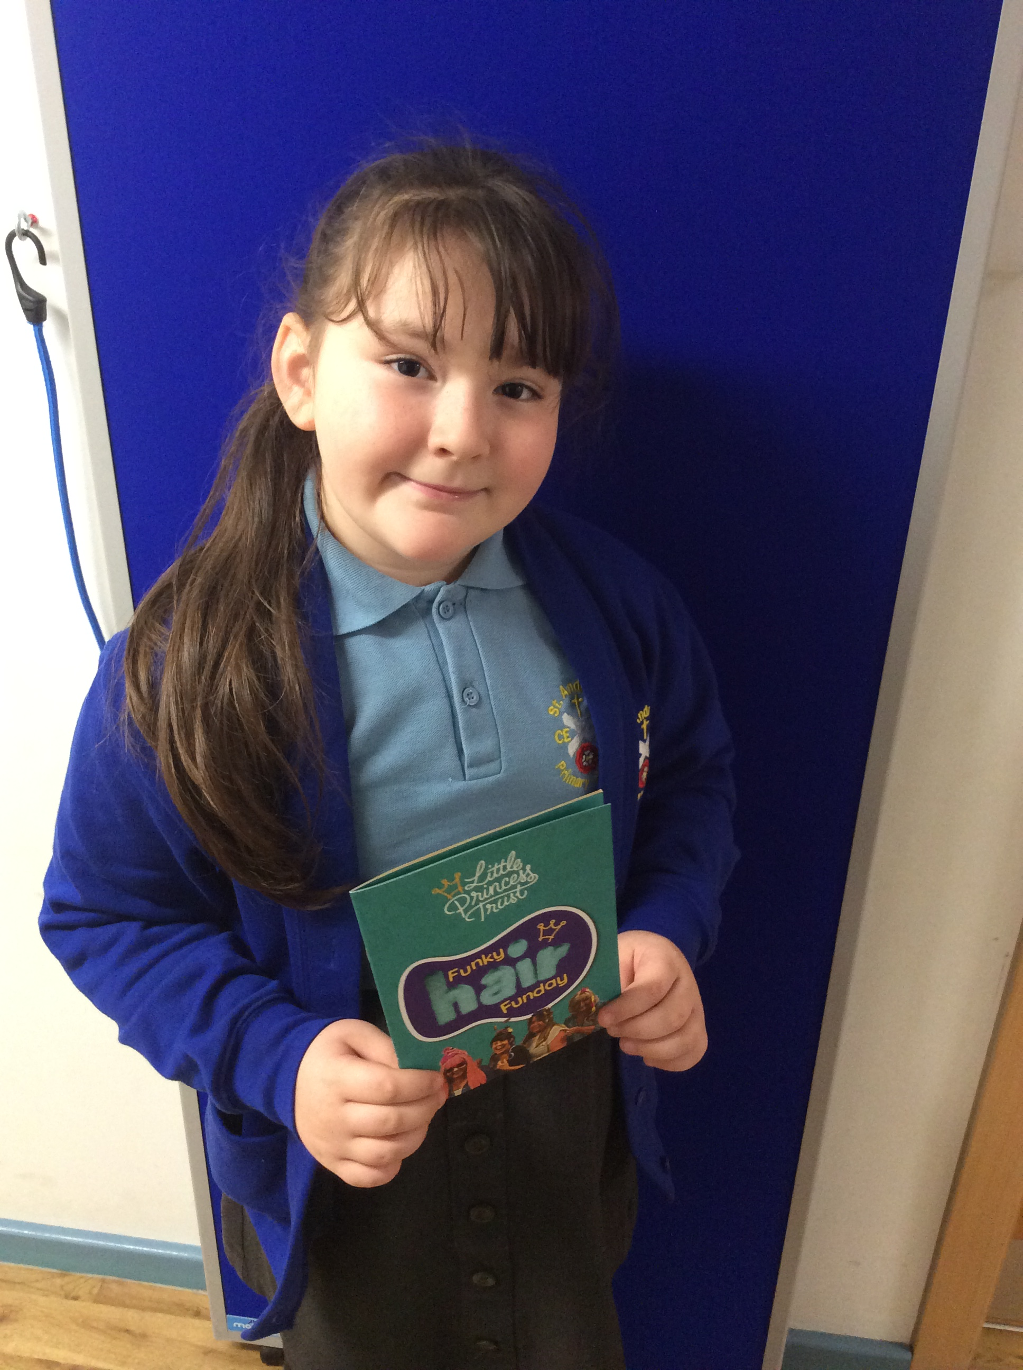
Erin-Rose – Year 4
Erin-Rose has been growing her hair for quite awhile, but she has not just been doing this for herself. She is intending to have her hair cut-off very soon so it can be donated to the Little Princess Trust, who will turn her hair into a wig for a child suffering from cancer.
To ensure the hair can be used, Erin-Rose also needs to collect money for the costs of making the wig. She asked if school could hold a fundraising event to support her. We are having a FUNKY Hair day, asking everyone to make a donation to come to school looking funky!!
I ASPIRE: INDEPENDENCE AMBITION SELF-CONTROL PERSEVERENCE INTEGRITY RESPONSIBILITY EMPATHY

Slide 3
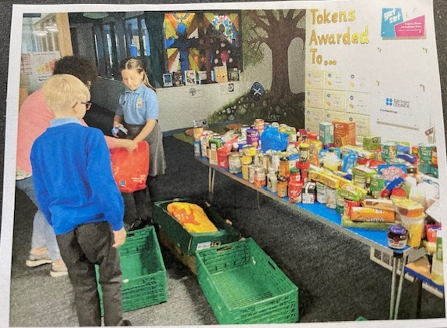
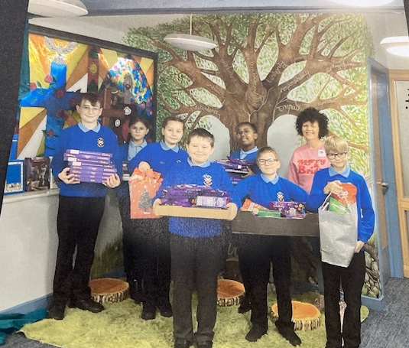
Worship Team
At Harvest time the Worship Team invited Selena from the Weston Favell Foodbank to come and talk to them about what our donations would be used for. They were really moved to discover how many families were relying on the food parcels to keep fed.
They were so keen to help that following a huge donation made in September they launched an appeal to collect chocolate goodies, so each food bag that went out prior to Christmas would include a sweet treat. Again our school family did not let us down and we were able to call Selena back to collect all the selection boxes, chocolates and advent calendars that we gathered.
One of the team said ‘ it is important that we help if we can. I would not be happy to think no one would help me if I needed it, so I should do what I can too’
I ASPIRE: INDEPENDENCE AMBITION SELF-CONTROL PERSEVERENCE INTEGRITY RESPONSIBILITY EMPATHY

Slide 4
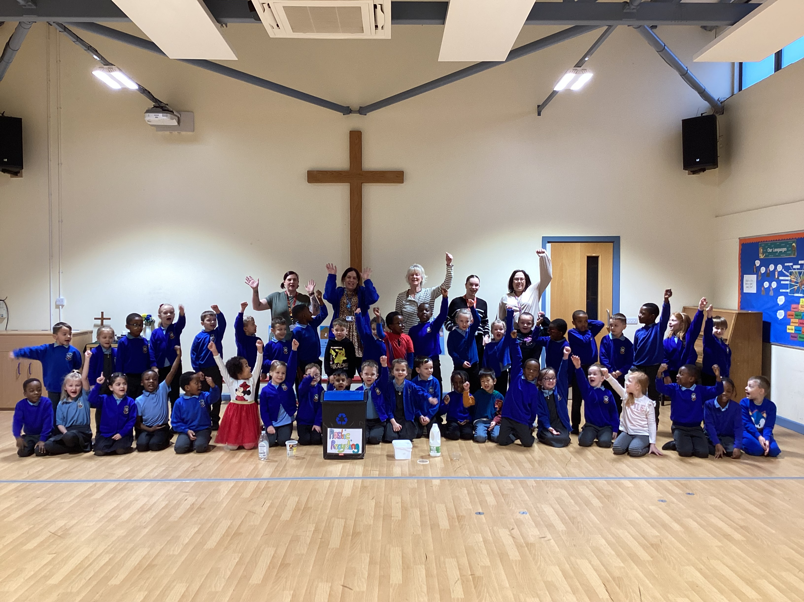
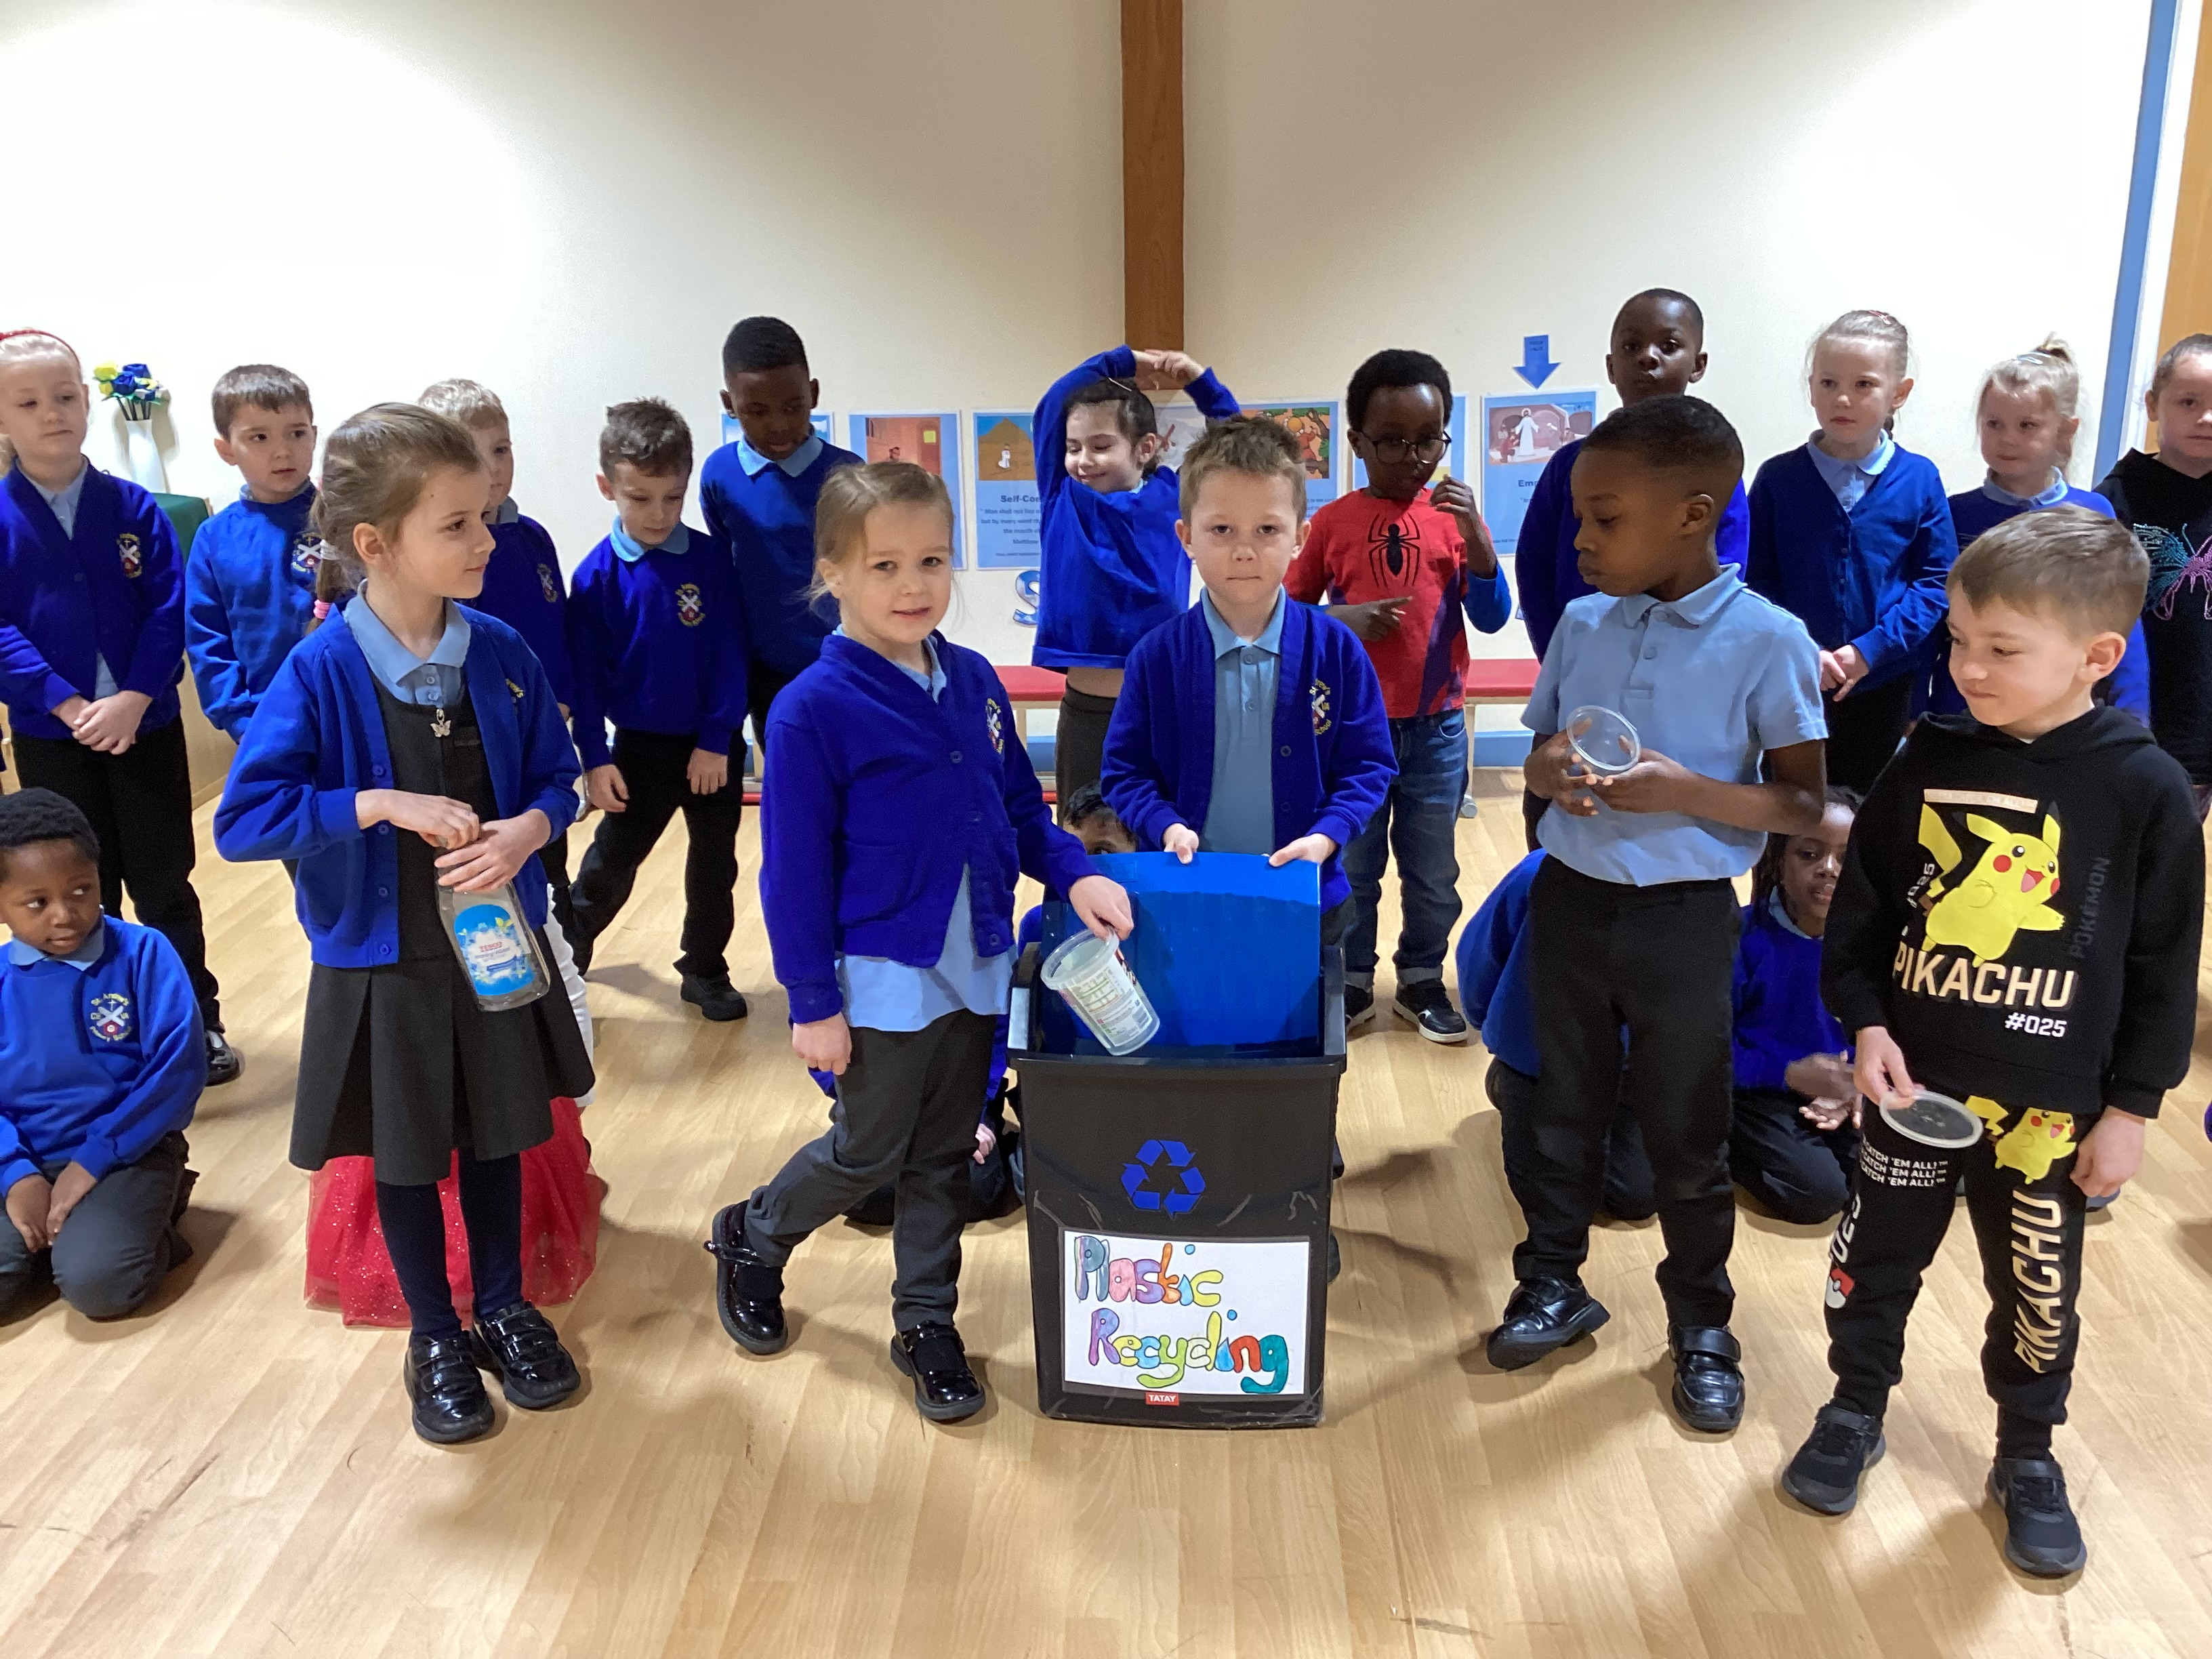
Year 1
In Year 1 the children watched a video of how plastics in the ocean can affect the ocean wildlife and were keen to see a drastic change if they could.
They realised that little steps in plastic recycling could indeed make a difference and decided that we could make more of an effort to recycle plastics we use in Year 1.
They now have a plastics bin in the Year 1 corridor and are in the process of collecting as much waste plastic as they can so it can be recycled rather than sent to landfill, or left to cause damage to the environment.
They are hoping that other year groups might join them too.
I ASPIRE: INDEPENDENCE AMBITION SELF-CONTROL PERSEVERENCE INTEGRITY RESPONSIBILITY EMPATHY

Slide 5
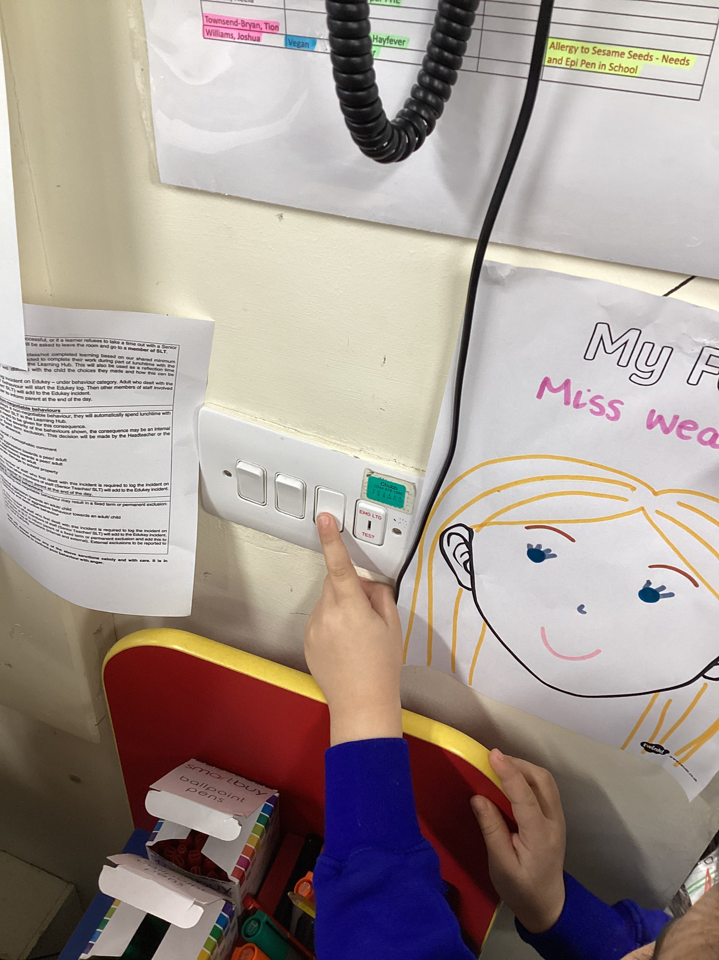
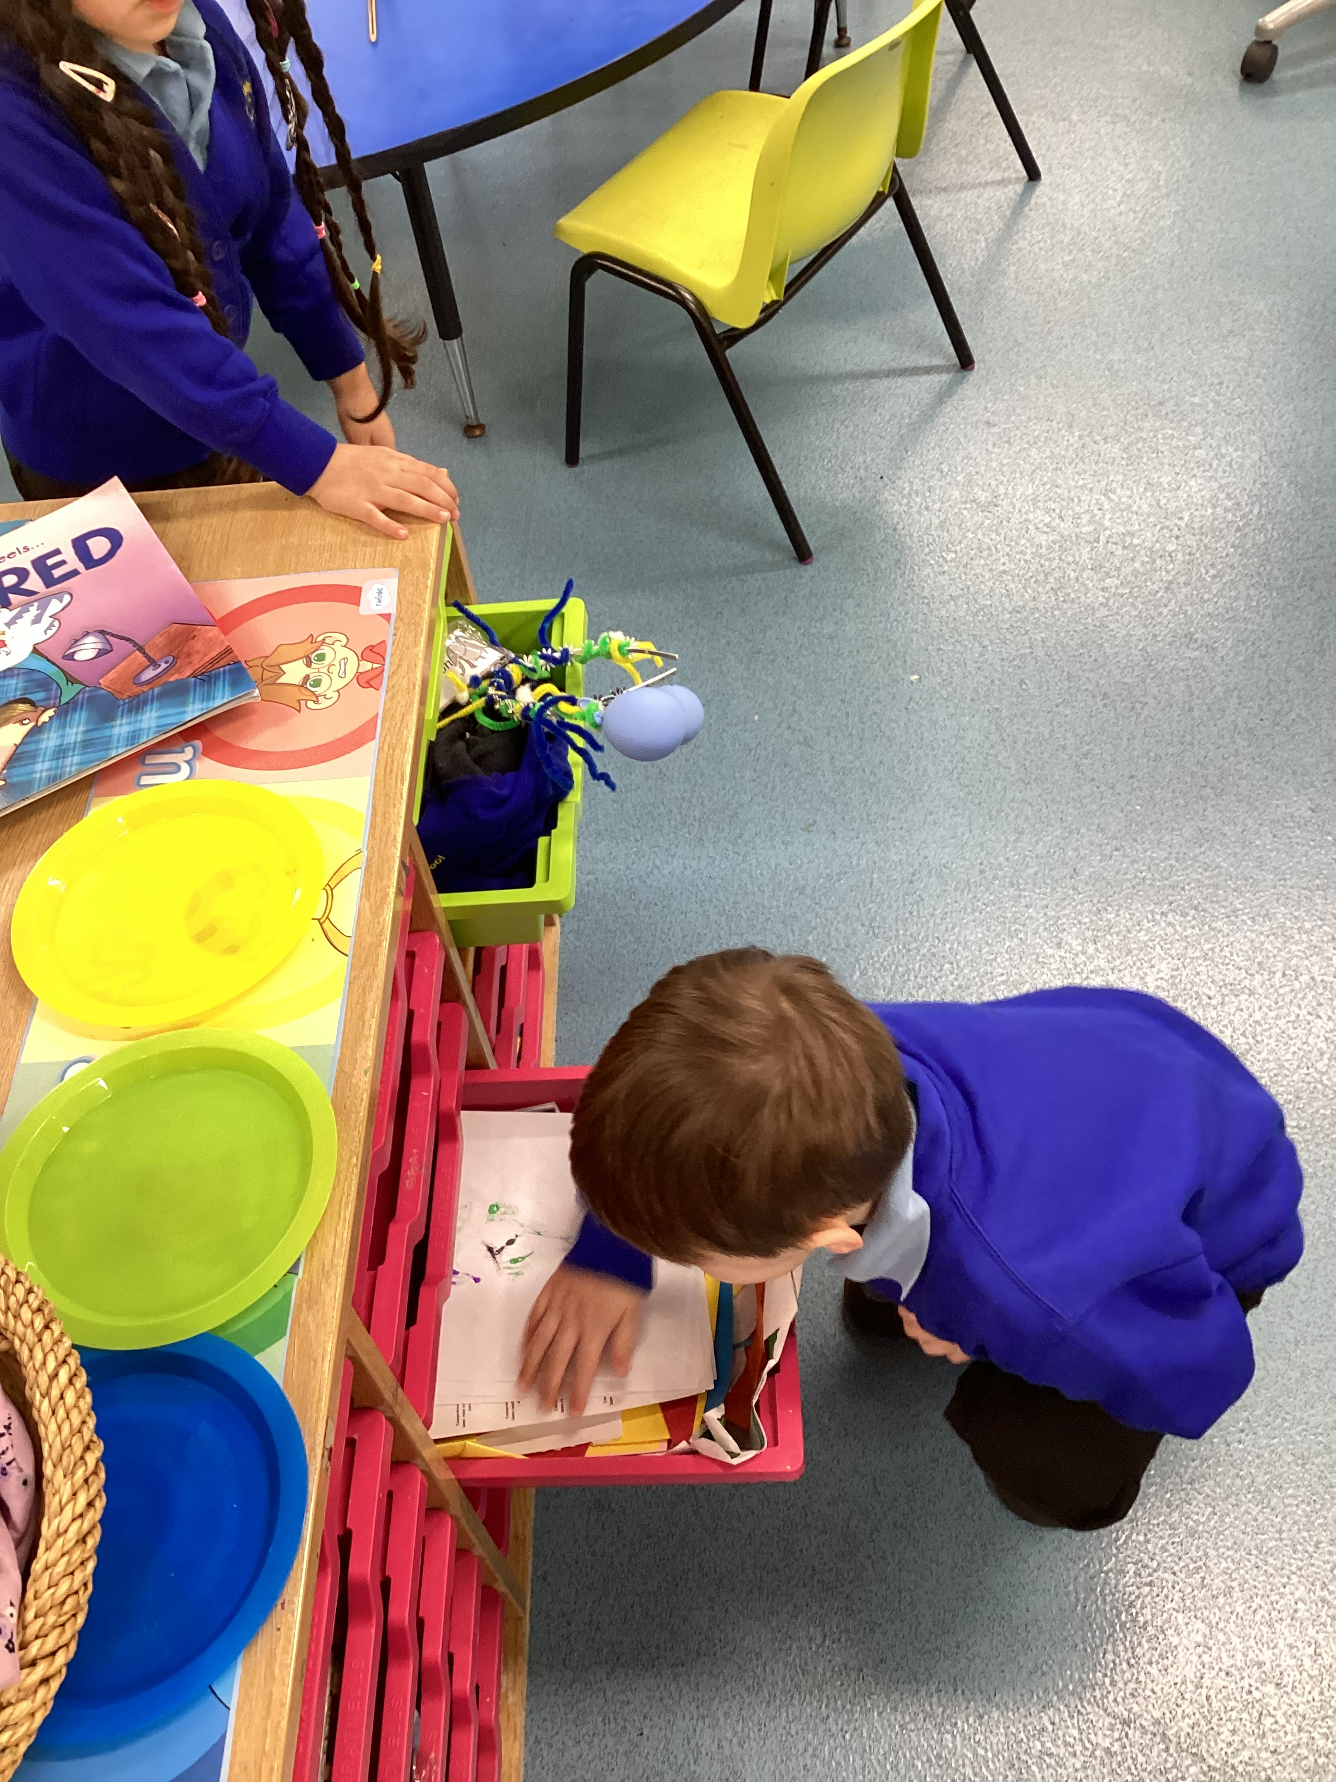
Reception
Sywell and Holcot Classes have been thinking about how they can help the environment more in their classrooms.
They talked about recycling and the children decided that they should have a draw in their rooms where you could put paper you have finished with, so other people could use it. This means they throw less away in the bin.
They also decided that leaving the lights on in the classroom was not a good idea. They now make sure that when they leave, for worship or for lunch, that someone switches the lights off.
I ASPIRE: INDEPENDENCE AMBITION SELF-CONTROL PERSEVERENCE INTEGRITY RESPONSIBILITY EMPATHY

