Slide 1
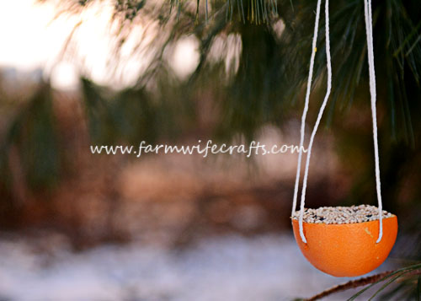
Leftover Christingle Oranges
Birdfeeders
After Christingle is over, families leave with their christingles (mostly minus the sweets) only for the oranges to go to waste.
These can easily be recycled into bird feeders to give the birds a treat over Christmas too!
Remove the candle, cocktail sticks, and tape
Cut off the top of the orange and scoop out the flesh from the bottom half
Half fill with bird seed
Pop onto the birdtable or thread a bamboo skewer through from side to side and use the holes to thread through some string to hang in a tree.
More information and ideas at https://www.farmwifecrafts.com/orange-bird-feeder/

