Slide 1
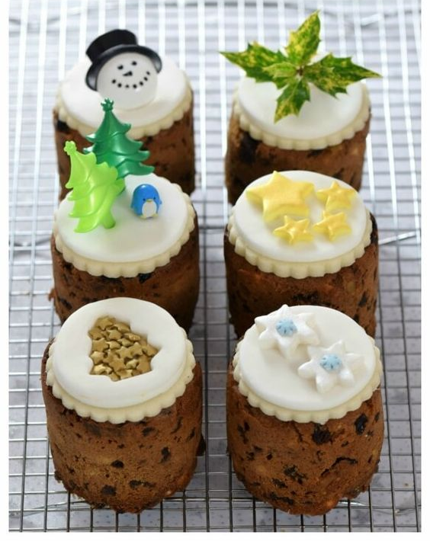
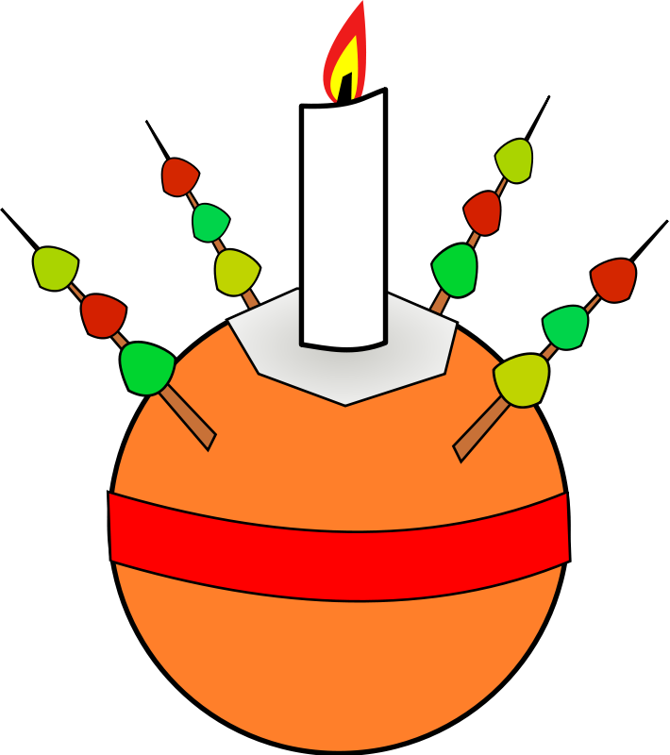
Christmas Cake Decorating
What does the Bible say:
The wise men followed the star to find Jesus. They gave the baby gifts of gold, frankincense and myrrh
Based on Matthew 2: 11
You will need:
a Christmas cake, ribbon, glue dots, jam, fondant icing, decorations, bag
What you need to do…
Place a little apricot jam onto the top of the case
Top with fondant icing and decorate
Add a ribbon
Place in a bag to take home?
Why are we doing this activity?
We are making these little gifts to remind us of the gifts the wise men gave to the baby Jesus

Slide 2
What does the Bible say:
The wise men followed the star to find Jesus. They gave the baby gifts of gold, frankincense and myrrh
Based on Matthew 2: 11
Leaders Notes:
We have made these cakes using various recipes. This recipe was a favourite - https://www.fromthecomfortofmybowl.com/vegan-jamaican-fruit-cake/. We substituted the alcohol for orange juice.
We have baked these cakes in deep muffin tins, in small baked bean tins cleaned and lined with baking parchment, or as a large cake which we have then cut up (this was a bit wasteful – although the volunteers happily cleared up the leftovers.
We do not use marzipan, but top with icing and decorate. We often use a star cutter for icing shapes and silver balls I have also tried the snowman shown in the top left, using a small pice black findant icing for the hat and an icing pen for the face.
We have asked members of the congregation who regularly help us to prepare food to back 6 or 12 cakes each and offered to supply ingredients, although most have kindly donated them.
This cake does not need to be ‘fed’ so can be made closer to your event for late
planners like me!

