Slide 1
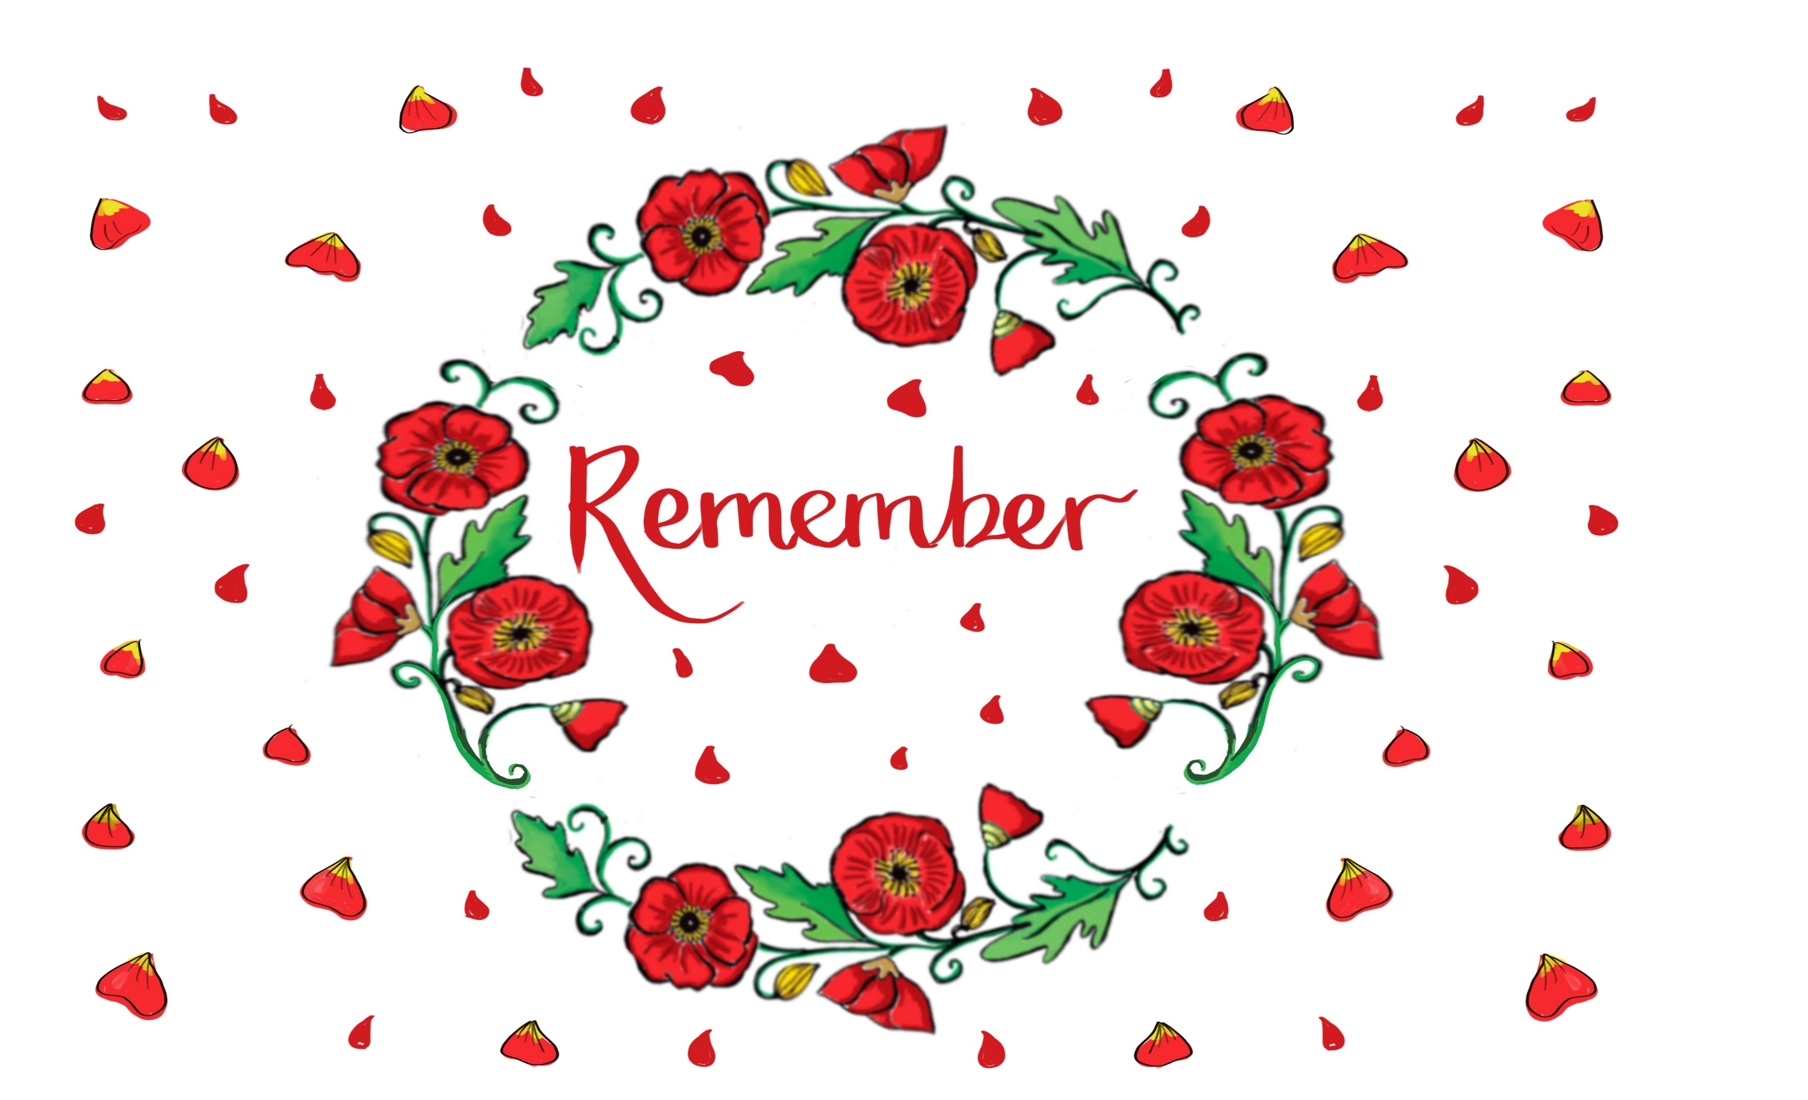

Welcome to our Collective Worship
You are listening to ‘Benedictus’ by Karl Jenkins, from ‘The Armed Man’ - part of his ‘Mass for Peace’.
Click here
Notes:
Consider the ways in which you have prepared the space for worship. As the children come in, you can choose music that promotes reflection and engagement- or music that is relevant to today’s theme or value. I have suggested the ‘Benedictus’ movement from ‘The Armed Man’, which has come to symbolise hope and peace.

Slide 2
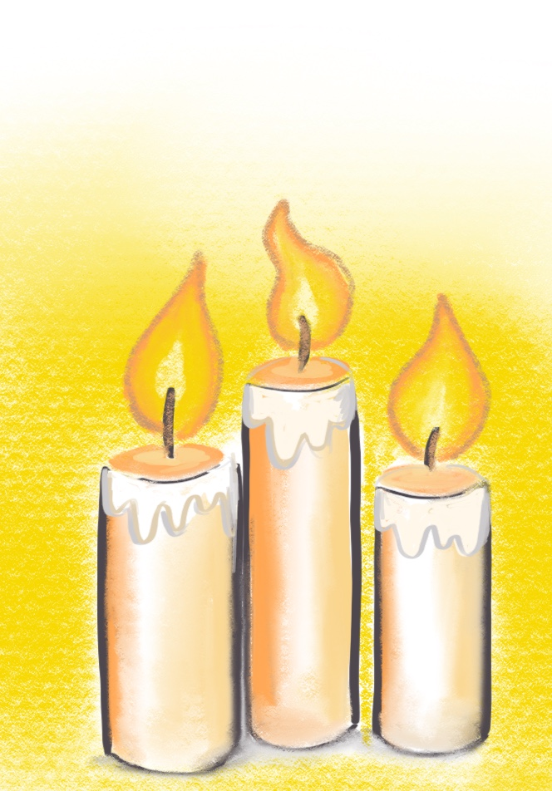

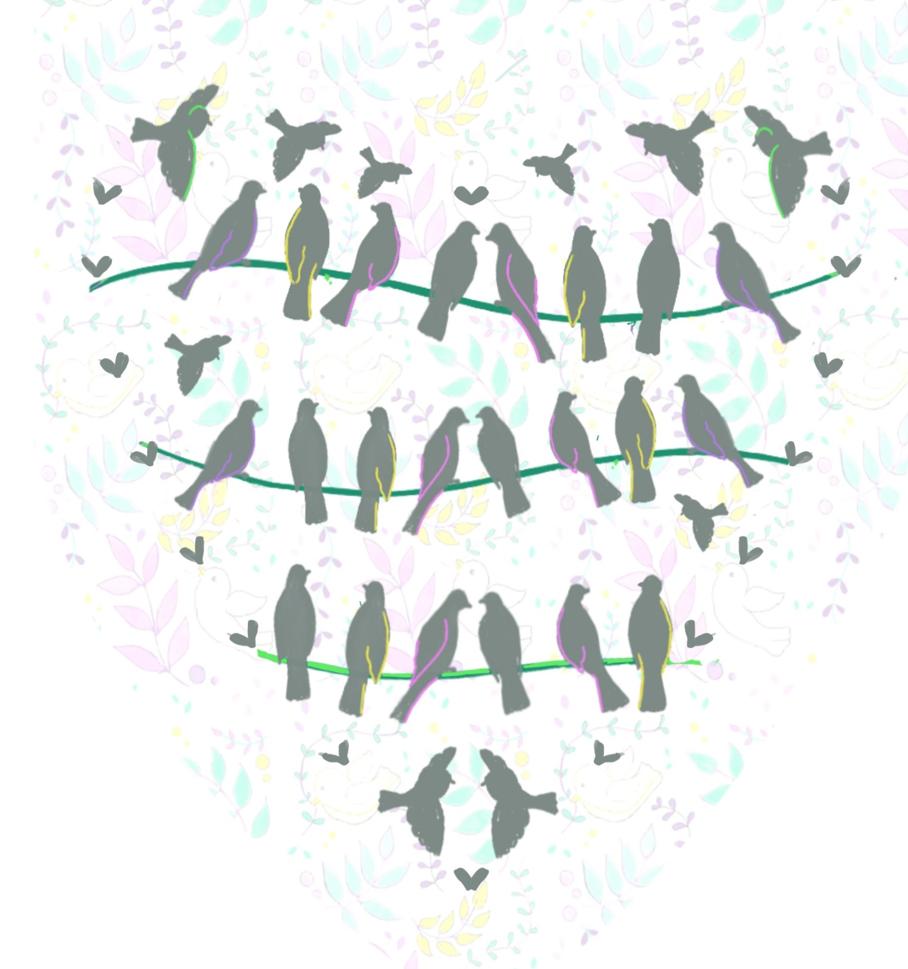
As we gather today, we invite you to celebrate the joy of being together in the presence of God the Father, God the Son and God the Holy Spirit
We welcome you all to a special worship
We come together today as a school family
To think about others
We come together as a school family
To think about peace
We come together as a school family
To say thank you
We come together as a school family
To remember
Board of Education
Notes:
GATHERING: Ensure that all feel welcomed into the worship space. Gathering words should be familiar and reflective, and these can refer to your school’s vision. It is important to set the atmosphere for today’s worship, and these welcome words can be used or adapted for your own school.

Slide 3
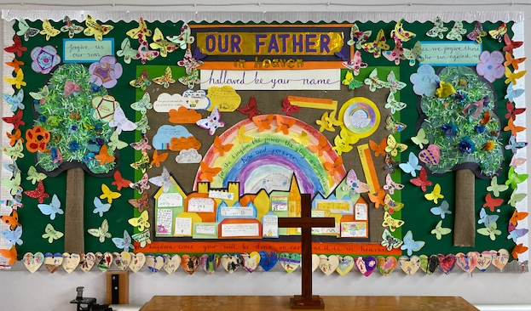
Notes:
Within Collective Worship, everyone is invited to pray or reflect. Ensure that any shared prayers are understood by the children, and not just ‘recited’. Many schools begin with a known, shared prayer as another way to set the atmosphere/ ethos of worship. ‘Amen’ should be used as an invitation, with pupils and adults joining in if they agree- or adults and children can just sit quietly and reflect.

Slide 4


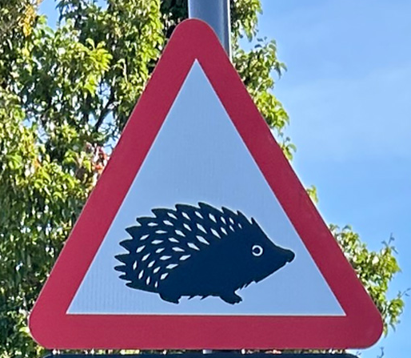



What new things will we look at today?
Today we are going to be thinking about the importance of remembering things. Sometimes it is really helpful to have symbols to help us with this. What would these symbols remind us to think about?
Notes:
ENGAGING: After everyone has ‘gathered’, and the atmosphere has been set, the next phase is ‘engaging’. Today we are thinking about symbols that remind us to think about things- the chosen symbols here will remind us to think about recycling, to take care of ourselves and to think about small creatures. The cross is a symbol that reminds Christians to think about God’s love.

Slide 5

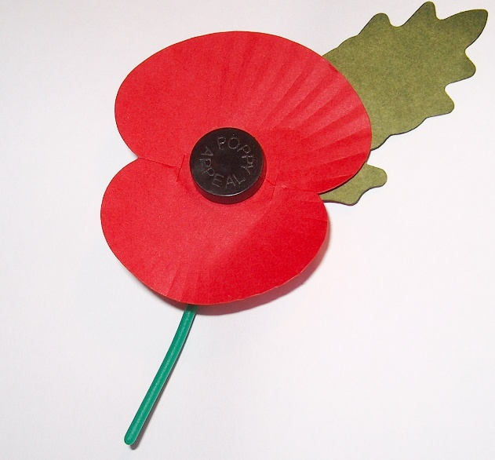

Now think about THIS symbol…
Today we will be finding out more about a symbol that is particularly important at this time of year.
Why do we see so many people wearing the poppy?
What does it remind us to do?
Notes:
ENGAGING: Thinking about the importance of the poppy. The poppy is a symbol that encourages us all to reflect on the bravery of others, and to thank all of those who made sacrifices for the good of our country.

Slide 6
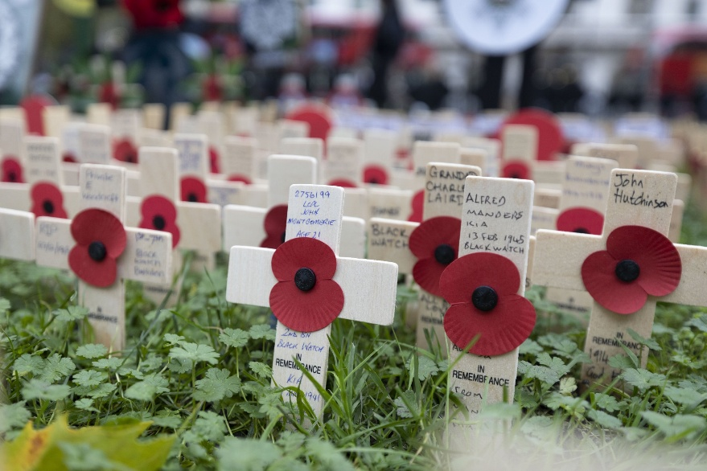
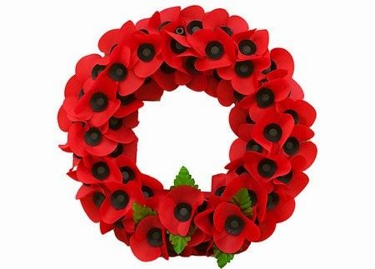
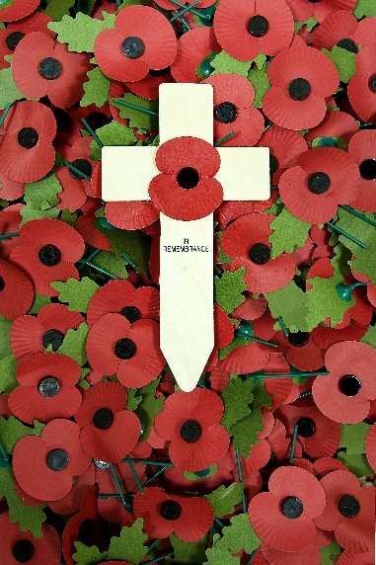
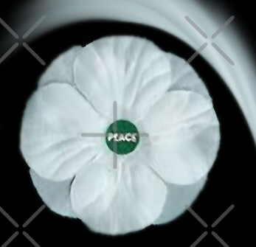
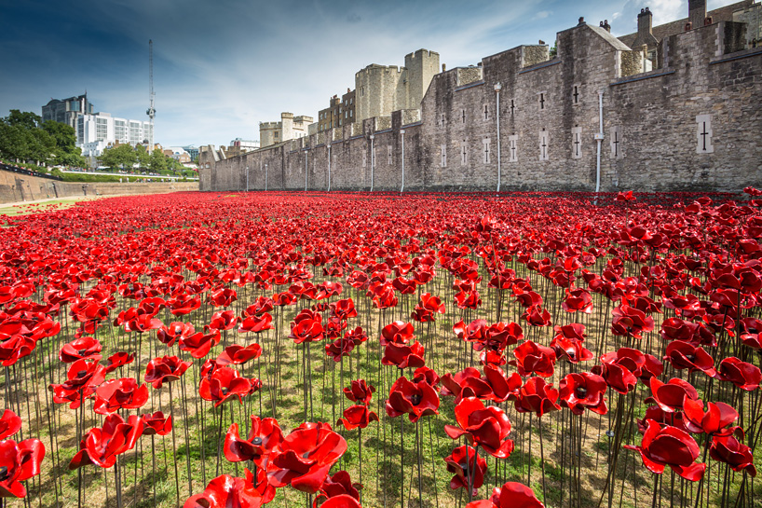
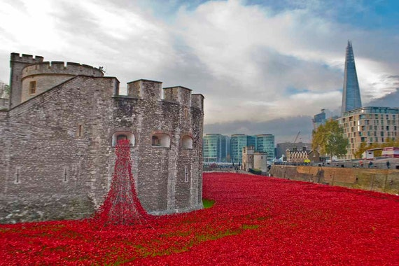
Notes:
The poppy is a powerful symbol of Remembrance, that encourages everyone to remember the sacrifices of others so that we all remember to work together- for peace in our future. In 2018, 100 years after the end of WW1, there was a poppy planted for every fallen soldier from our country – 888, 246. The poppy encourages us to remember, even with the passing of time. It encourages us to thank others, and to reflect more deeply on how we respond when things are wrong. Some people choose to wear a white poppy as a reminder of the importance of peace.

Slide 7
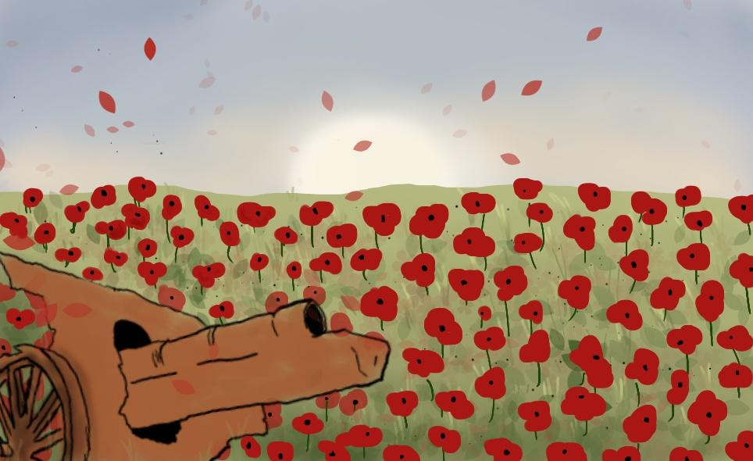
So … why do we have a Remembrance Poppy?
To trace the history of the Remembrance Poppy we have to journey back to a time and place stripped of almost all beauty and compassion … to one of the most devastated areas of World War 1, and yet a place that came to represent how hope can rise from even the darkest times.
Notes:
The significance of the poppy can be traced back to WW1, and a particularly devastating battlefield.

Slide 8
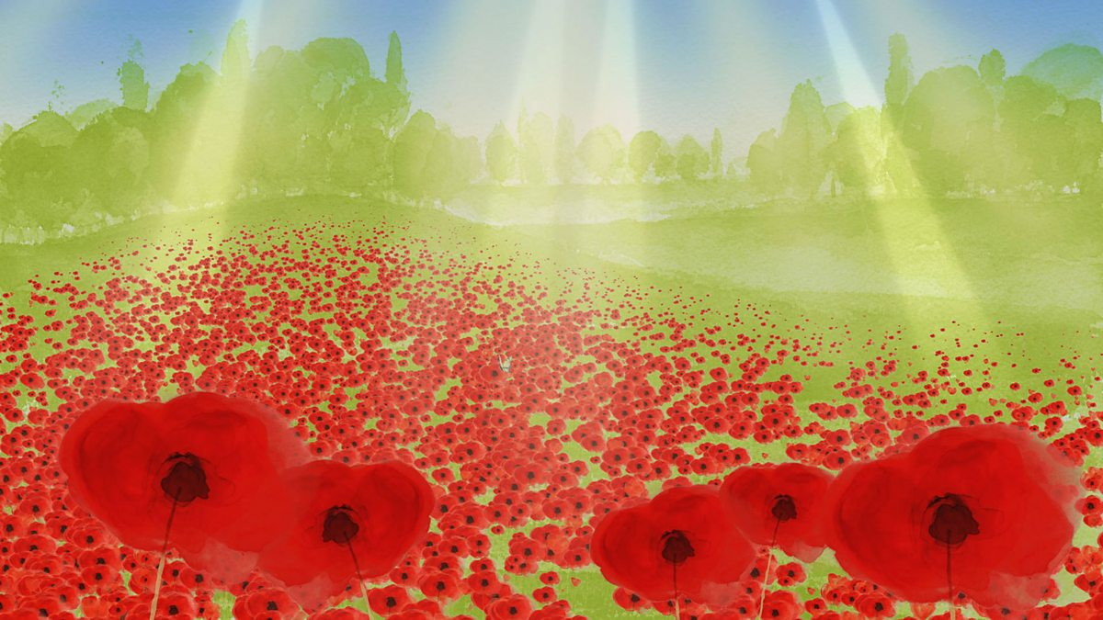
Watch this short video
Poppies
Notes:
This short video is suitable for all ages of children and shares the origins of the importance of the poppy in a gentle, thought-provoking way.

Slide 9
After the most devastating battle at Flanders Fields, delicate red poppies somehow found a way to grow, and this inspired one of the most memorable war poems, written by John McCrae. It has touched the hearts of millions of people since it was written in 1915.

Slide 10
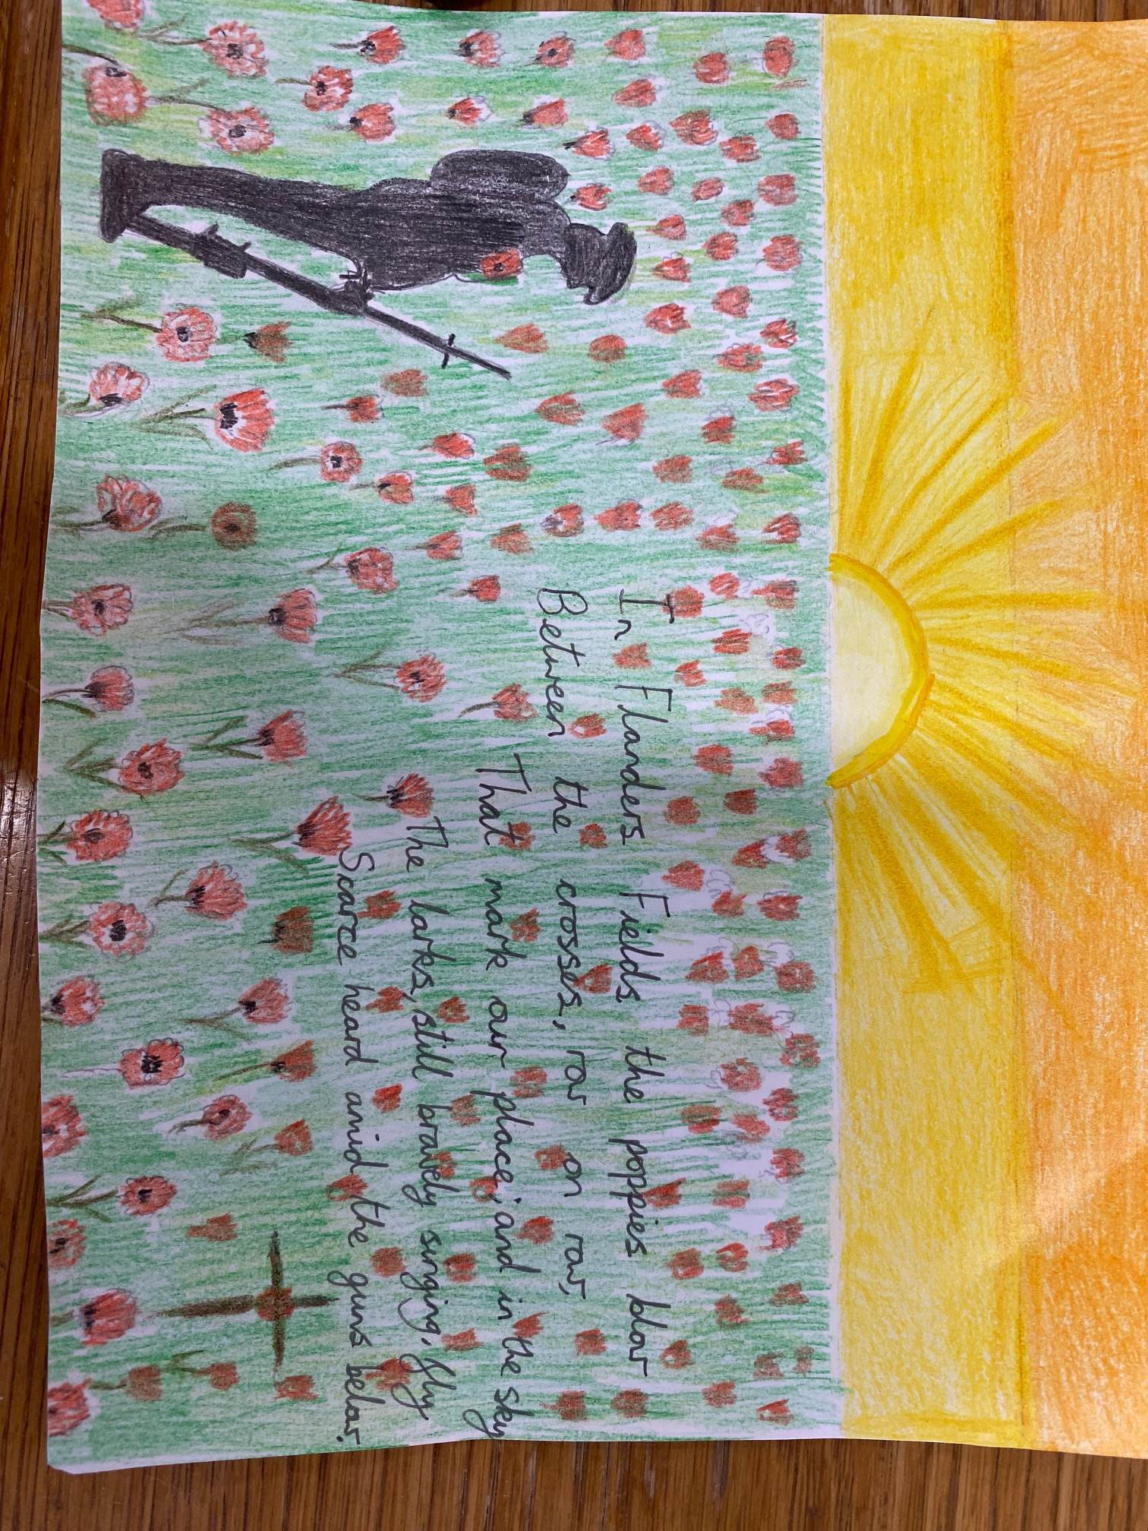
In Flanders Fields the poppies blow
Between the crosses, row on row,
That mark our place; and in the sky
The larks, still bravely singing, fly
Scarce heard amid the guns below
Extract from ‘In Flanders Fields’, by Lieutenant Colonel John McCrae
Notes:
This moving poem reflects on the sacrifices made during WW1, and it reminds everyone to continue to focus on the importance of doing everything possible to ensure peace and freedom.

Slide 11
The effect of the poem on Moina Michael, an American professor, was so great that she pledged to KEEP THE FAITH and always to wear a red poppy of Flanders Fields as a sign of remembrance and to use it as an emblem of ‘keeping the faith with all who died.’ She drove forward the idea of making the poppy a symbol for remembering all those lost in war. She composed her own poem entitled, ‘We Shall Keep the Faith’.
Here is an extract from her poem:
And now the Torch and Poppy Red
We wear in honour of our dead.
Fear not, that ye have died for naught,
We’ll teach the lesson that ye wrought
In Flanders Fields.
In Flanders Fields we fought.
Notes:
“We must remember these brave young men. Not just now, but into the future, too.”

Slide 12
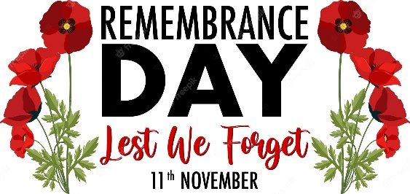
We will continue to Remember…
Notes:
This slide is blank, for you to insert any memories that relate directly to your school and its community.

Slide 13
We will continue to Remember…
They shall grow not old as we are that are left grow old:
Age shall not weary them, nor the years condemn.
At the going down of the sun and in the morning
We will remember them.
All: We will remember them.

Slide 14
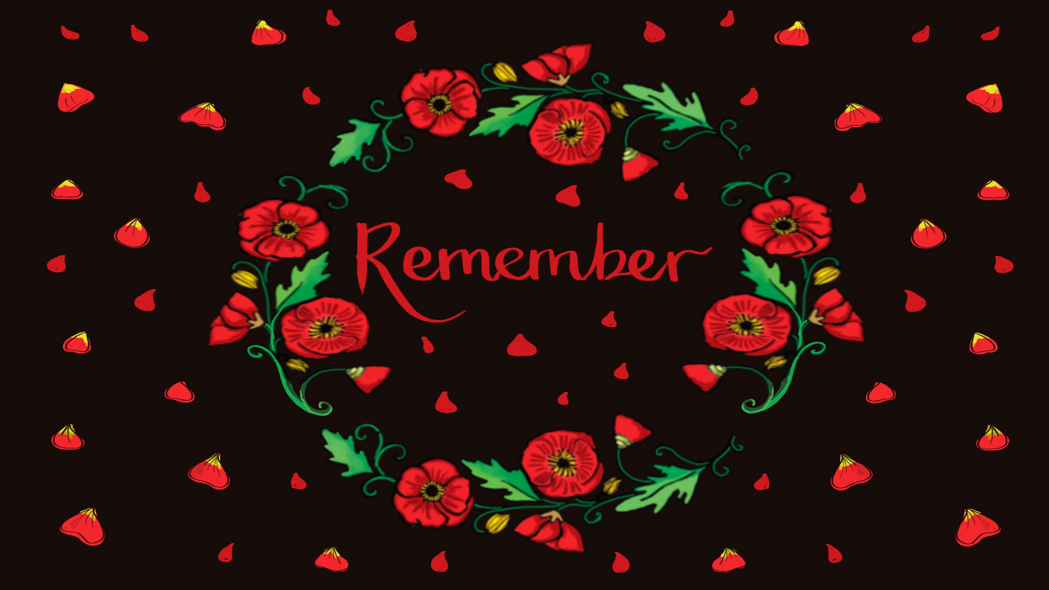

Notes:
At 11 o’clock on the 11th November 1918, the guns fell silent as the end of WW1 was declared. We continue to use this time to remember all those who made sacrifices in this war and every war since. We mark this special time with a two-minute silence, across the country.

Slide 15

In the Bible, Jesus reminds us of the importance of standing against injustice, and caring for those in need.
Matthew 25:35-40
"For I was hungry and you gave me something to eat, I was thirsty and you gave me something to drink, I was a stranger and you invited me in, I needed clothes and you clothed me, I was sick and you looked after me, I was in prison and you came to visit me."
"Then the righteous will answer him, 'Lord, when did we see you hungry and feed you, or thirsty and give you something to drink? When did we see you a stranger and invite you in, or needing clothes and clothe you? When did we see you sick or in prison and go to visit you?'
The King will reply, 'Truly I tell you, whatever you did for one of the least of these brothers and sisters of mine, you did for me.'"
Notes:
This passage reminds us of the importance of caring for others and challenges us all to respond with compassion and action. Jesus speaks of the importance of caring for others and to actively love and serve others, particularly those in need.

Slide 16
In this Bible passage, we are reminded of the importance of caring for others, especially those in need. The passage emphasises that every act of kindness towards others is also seen as an act of kindness towards God.
The passage calls on people to help others, with love and compassion.
In World War 1, and in other wars since, people have been called upon to respond to injustice.
So many brave people have taken responsibility in standing against injustice, doing everything possible to secure peace.
We remember all of them.
Notes:
Jesus speaks of the importance of caring for others and to actively love and serve others, particularly those in need. In both of the world wars, countries were called upon to respond to injustice. We must not forget the lessons of these wars and remember our responsibility to stand against injustice.

Slide 17
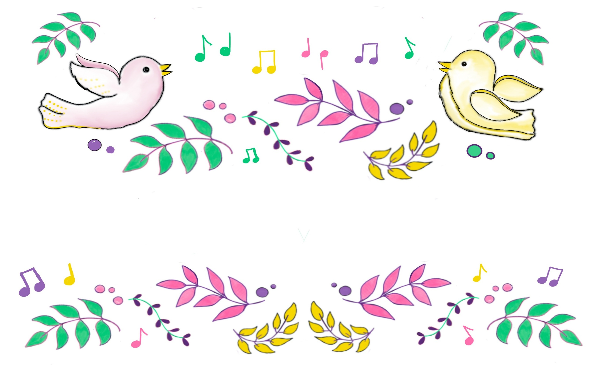
We invite you to share a song:
Today we invite you reflect on the importance of peace as we sing.
Make me a Channel of your Peace
Let there be Peace on Earth
Notes:
ENGAGING/ RESPONDING: Singing is an experience within worship providing a connection with self and something beyond self. Choose songs that reflect the context of the school and the focus of your worship. The song can be sung at any time, to complement your worship. You can choose Christian worship songs or songs that reflect Christian behavior and values, with a specific link to Christianity. We must, as worship leaders, remind everyone that singing is INVITATIONAL. You can choose a song linked to Peace, such as the suggestions here.

Slide 18


We invite you to pray or reflect
Lord,
Thank you for the gift of life.
Thank you for those who bless us and love us.
Thank you for Jesus, God’s greatest gift to us all,
Teach us to be joyful,
Help us to be grateful,
Remind us to be content with, and grateful for, all that we have.
May all of us remember to thank those around us
And to show and share gratitude in our everyday lives
Amen
Notes:
This is an opportunity to reflect on our experience in Collective Worship today through prayer or stillness. It can involve quiet reflection, shared prayers, children’s prayers or other prayers that important to your school. ‘Amen’ is used as an invitation for children and adults to use if they agree with the words of the prayer. It can also be a time of quiet reflection.

Slide 19


As we reflect today at the end of our worship, we take a quiet moment to thank all those heroes, past and present who have made sacrifices for our freedom.
Almighty God
We remember today all those who have suffered in wartime.
On this day of Remembrance help us to honour their lives and learn from all they taught us.
Grant us the strength to stand up for what is right,
And the compassion to show kindness and respect to all.
May we work together to build a world of peace, justice and dignity for all.
Amen
Board of Education
Notes:
A final prayer- and you could also share your own prayers linked to Remembrance.

Slide 20


.
As we leave Collective Worship today, we would like you to take some thoughts with you…
Who will you remember this week?
Spend some time thinking about someone who is special to you. How could you thank them?
Is there someone from the past who you feel grateful for?
Notes:
The ‘sending’ section of CW is very important. The door symbolizes the Inspiration from the worship, with the children and adults taking with them the experiences from the worship. What will be taken away from worship today? What will do differently? What will we think about over the coming days and weeks? From today’s worship, we will be looking at ways in which we can treasure the memories of those that are important to us.

Slide 21
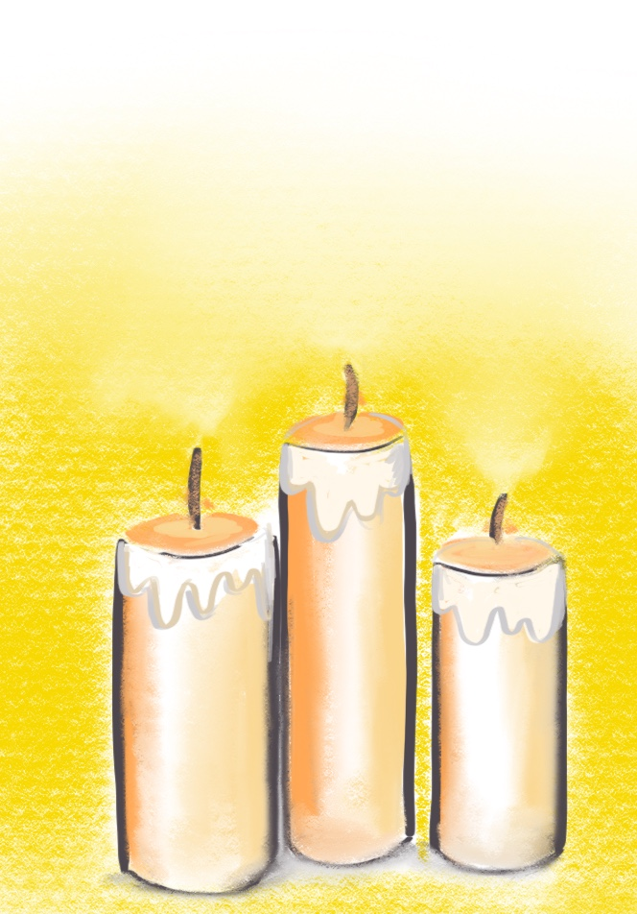
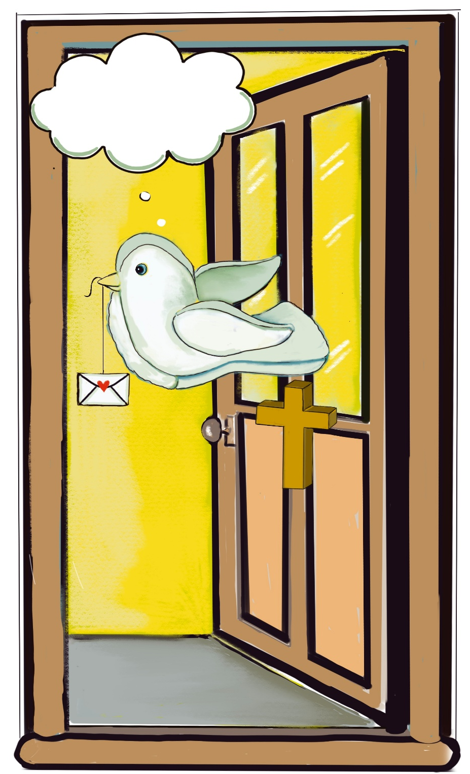
Take a quiet moment…
As you leave Collective Worship today, reflect on all you have heard.
Listen to the music…
Take thoughts of love and gratitude with you.
“ We must remember these brave young men. Not just now, but into the future, too.” Moina Michael
Notes:
Share final words of hope and encouragement. The candles being blown out marks the end of worship.

Slide 22
Thank you for sharing our Collective Worship
You are listening to a version of ‘The Last Post’, which is often played in honour of fallen soldiers.
The Last Post
Notes:
This version is played by Alexis Ffrench and Ralph Brill.

Slide 23


