Slide 1



Welcome to the Christmas treasure hunt!
Read the clue, when you know the answer find the matching picture.
The next clue is written under the picture.
Follow all the clues to get your prize!
All the clues are hidden in ___________________________________________ .
Happy treasure hunting!
Your first clue: Which takeaway food is very popular in Japan as a Christmas day meal?

Slide 2

Next clue: What fruit is used to make a Christingle?

Slide 3
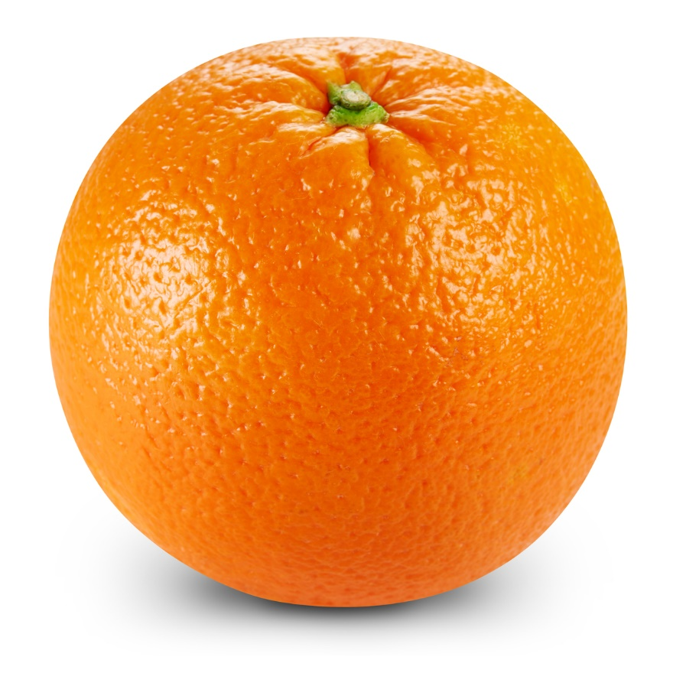
Next clue: Name the YouTube personality who won consecutive UK Christmas number 1’s in 2018, 2019 and 2020?

Slide 4
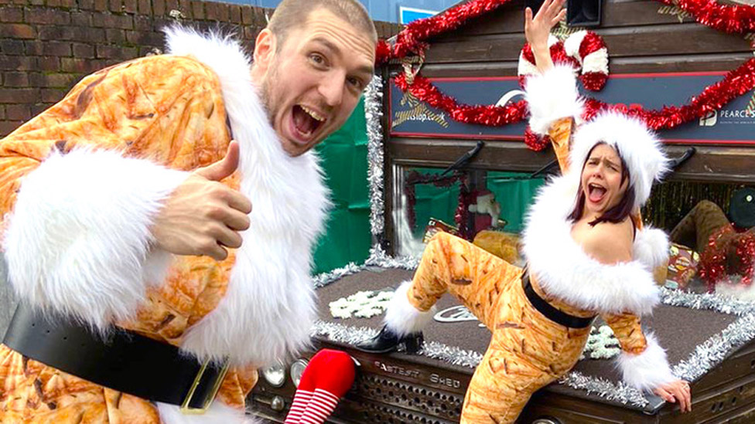
LadBaby
Next clue: In which fictional land is it always winter but never Christmas?

Slide 5

Next clue: What appeared in the sky when Jesus was born?

Slide 6

Next clue: In which Christmas movie does Tom Hanks play 6 of the characters?

Slide 7

Next clue: In Friends, what character does Ross invent to entertain his son Ben when he’s unable to get his hands on a Santa outfit?

Slide 8
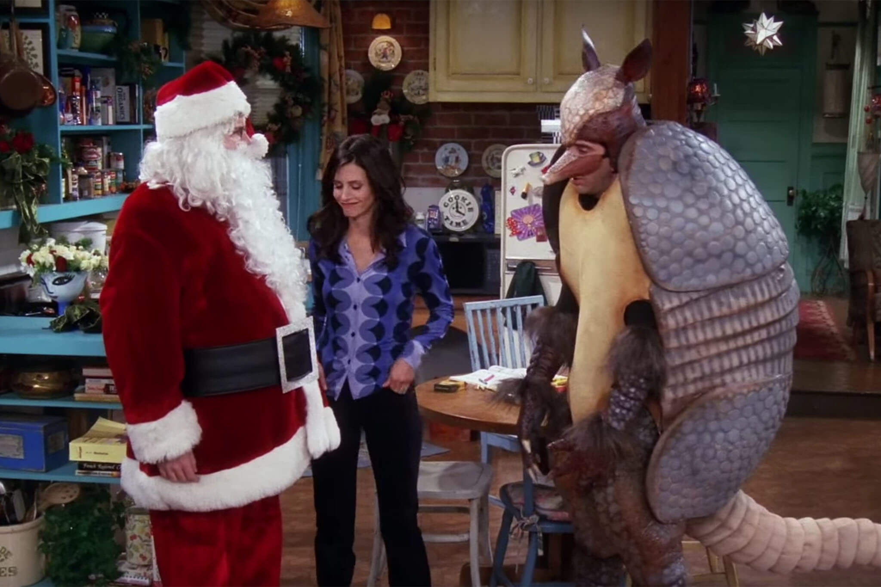
The Holiday Armadillo
Next clue: Where was Jesus born?

Slide 9

Next clue: In his first day at Hogwarts what did Dumbledore give Harry Potter for Christmas?

Slide 10
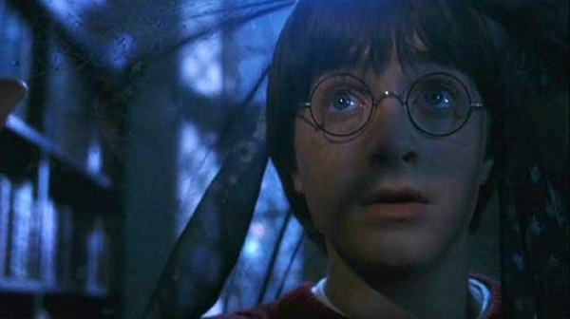
The Invisibility cloak
Next clue: Who tried to kill Jesus as a baby?

Slide 11
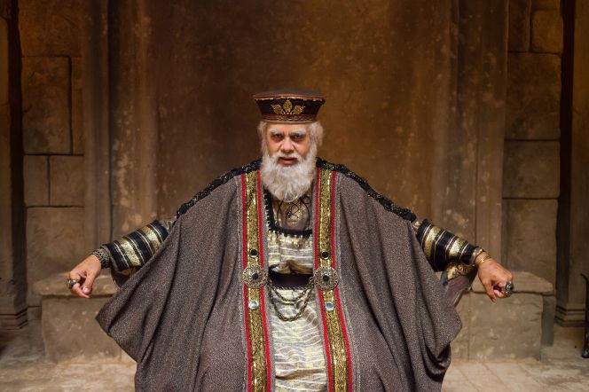
King Herod
Next clue: What sauce do you have with turkey?

Slide 12
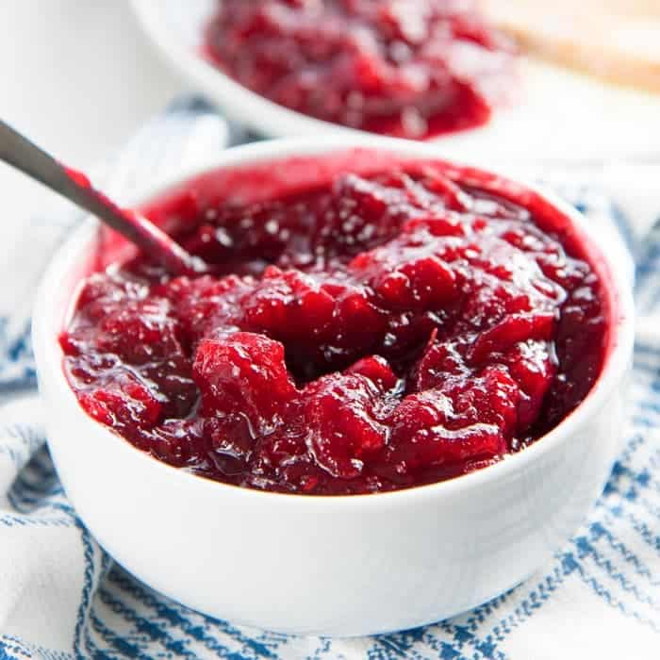
Cranberry sauce
Next clue: Who visited Jesus first?

Slide 13
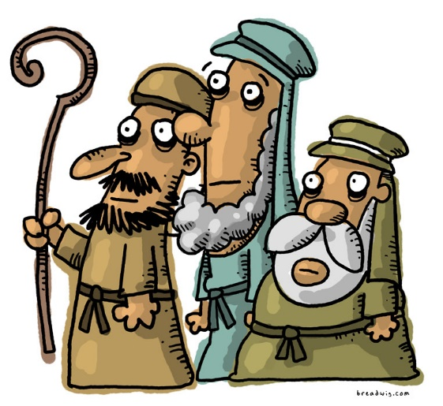
The Shepherds
Next clue: In the 12 twelve days of Christmas what was given on the 4th day?

Slide 14

Next clue: Who went walking in the air?

Slide 15
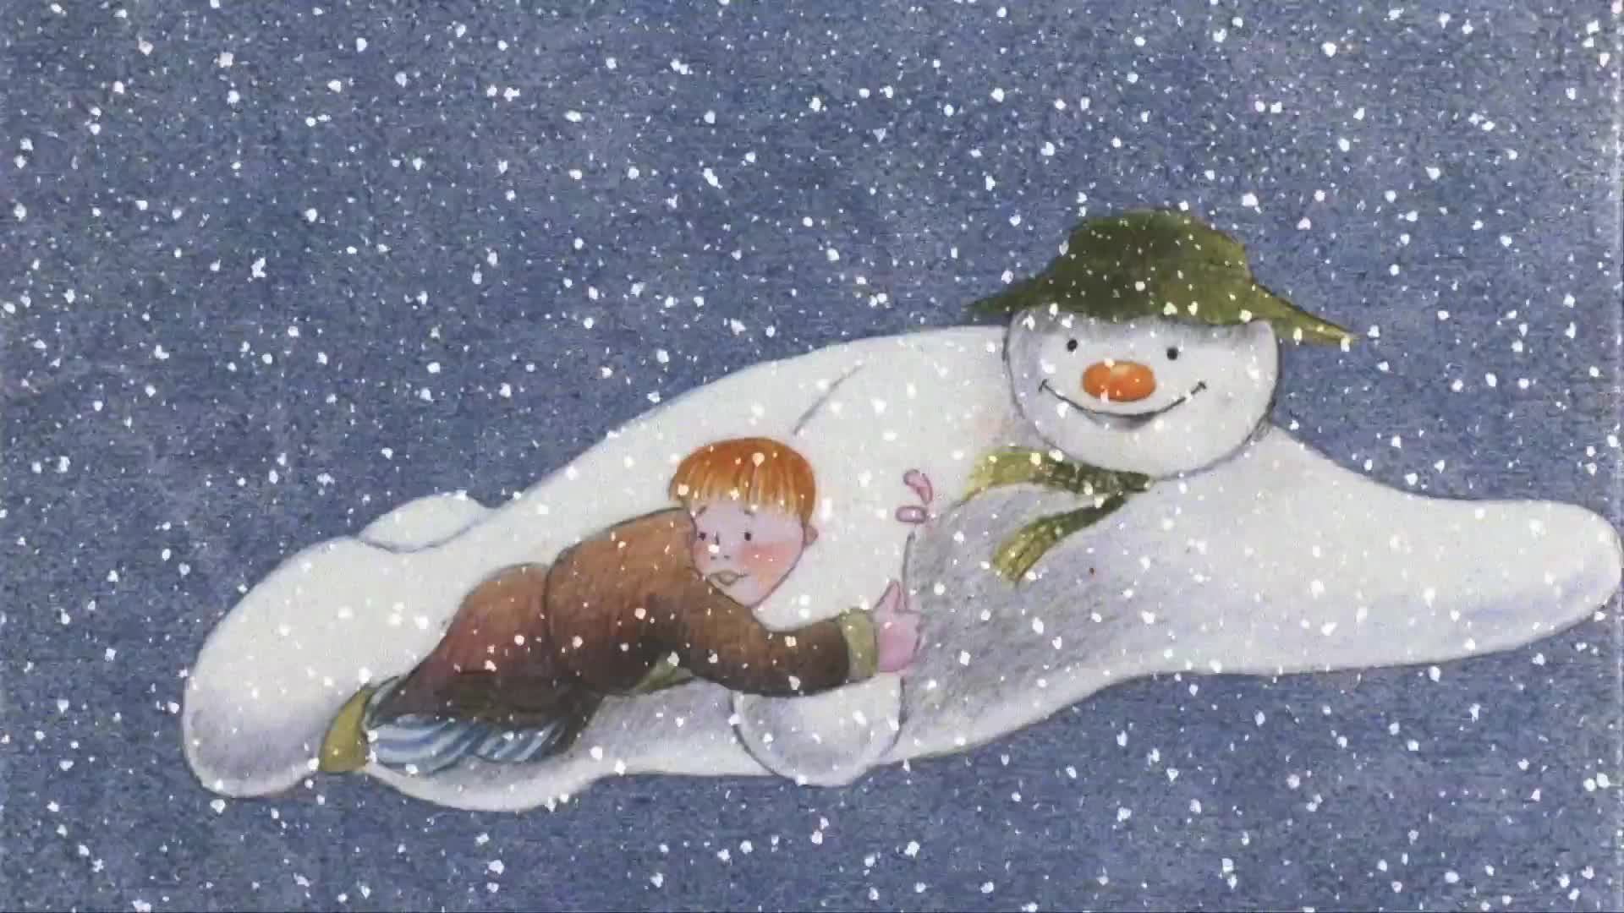
The Snowman
Next clue and final clue: What does the word ‘Immanuel’ mean?

Slide 16

Well done- you’ve finished the treasure hunt!!
Find_____________________ in the __________________for a prize!

